Slide 1
Introduction to Chatbots and Dialogue Systems
Chatbots and Dialogue Systems

Slide 2
Conversational Agents
(AKA Dialogue Systems AKA Dialogue Agents AKA Chatbots)
Personal Assistants on phones or other devices SIRI, Alexa, Cortana, Google Assistant
Playing music, setting timers and clocks Chatting for fun
Booking travel reservations Clinical uses for mental health

Slide 3
Two kind of conversational agents
Chatbots
  mimic informal human chatting
  for fun, or even for therapy
(Task-based) Dialogue Agents
  interfaces to personal assistants
  cars, robots, appliances
  booking flights or restaurants

Slide 4
Chatbot Architectures
Rule-based
1. Pattern-action rules (ELIZA)
2. + A mental model (PARRY):
The first system to pass the Turing Test!
Corpus-based
Information Retrieval (XiaoIce)
Neural encoder-decoder (BlenderBot)

Slide 5
Will you sing me a song?
Sure, what do you want to be sung to? I can sing you a song about baking.
Yes, sing me a song about baking!
Do you want me to sing it to the tune of “Sing Along with Mitch”?
Yes, I would love that.
OK, I’ll try to get it to you by the end of the day. What else do you like to do?
No, sing it to me now!
OK, give me a few days. I’m a teacher, so I don’t have much free time.
Can you at least tell me what the lyrics are?
Sure, it goes like this: “Baking is my favorite thing to do in the world.”
How does the chorus go?
It goes: BAKING IS MY FAVORITE THING TO DO IN THE WORLD!
Wow, sounds like a bop.
BlenderBot (Roller et al. 2020)
I know, right? It’s so catchy. I can’t get it out of my head.

Slide 6
XiaoIce (Zhou et al., 2020)
∫{= ✏∞`}
✏∞= `}@,
(Í¡«
[Human] [XiaoIce]
Hello, XiaoIce.
Hello, your profile pic is interesting. Like I’ve seen it somewhere.
`4œ} £, …
∫{= ✏∞= | /⌫ – /ÍË®;ÃÑ@ | [Human] [XiaoIce] | Really? Is it | a | comic | character?
∫{= | ` HÂSÑ | [Human] | How do you know that?
✏∞= | `⌧ | [XiaoIce] | Guess.
∫{= | æS`/N∫⌫? | [Human] | Are you human?
✏∞= Ÿ*, `å⌘⇢JJ1ÂSÜ
∫{= ` /∫Âz˝:h∫H
✏∞= /» 7, ⌘ ⇢∑∞∞Ñ˘
Ö`Ñ
[XiaoIce]
Well, you’ll know it after chatting with me more.
Aren’t you an Al chatbot?
[Human] [XiaoIce]
So what? I won’t be indifferent to you.
What functions do you have? I have over 200 skills. name one you need.
∫{= `˝ ¿Hü˝J
✏∞= ⌘ 200⇢*skills,
`Ñ B
[Human] [XiaoIce]
e, Ù˙
Just

Slide 7
Task-based dialogue agents
"Task-based" or "goal-based" dialogue agents
Systems that have the goal of helping a user solve a task
  Setting a timer
  Making a travel reservation
  Playing a song
  Buying a product
Architecture:
Frames with slots and values
A knowledge structure representing user intentions

Slide 8
The Frame
A set of slots, to be filled with information of a given type
Each associated with a question to the user
Slot ORIGIN DEST
Type city city
Question
"What city are you leaving from? "Where are you going?
"What day would you like to leave? "What time would you like to leave?
"What is your preferred airline?
DEP DATE date DEP TIME time
AIRLINE line

Slide 9
Introduction to Chatbots and Dialogue Systems
Chatbots and Dialogue Systems

Slide 10
Properties of Human Conversation
Chatbots and Dialogue Systems

Slide 11
C₁: . . . I need to travel in May.
A telephone conversation between a human travel agent (A) and a human client (C)
A₂: And, what day in May did you want to travel?
C₃: OK uh I need to be there for a meeting that’s from the 12th to the 15th. A₄: And you’re flying into what city?
C₅: Seattle.
A₆: And what time would you like to leave Pittsburgh?
C₇: Uh hmm I don’t think there’s many options for non-stop. A₈: Right. There’s three non-stops today.
C₉: What are they?
A₁₀: The first one departs PGH at 10:00am arrives Seattle at 12:05 their time. The second flight departs PGH at 5:55pm, arrives Seattle at 8pm. And the last flight departs PGH at 8:15pm arrives Seattle at 10:28pm.
C₁₁: OK I’ll take the 5ish flight on the night before on the 11th.
A₁₂: On the 11th? OK. Departing at 5:55pm arrives Seattle at 8pm, U.S. Air flight 115.
C₁₃: OK.
A₁₄: And you said returning on May 15th? C₁₅: Uh, yeah, at the end of the day.
A₁₆: OK. There’s #two non-stops . . . #
C₁₇: #Act. . . actually #, what day of the week is the 15th? A₁₈: It’s a Friday.
C₁₉: Uh hmm. I would consider staying there an extra day til Sunday. A₂₀: OK. . . OK. On Sunday I have . . .

Slide 12
Properties of Human Conversation
Turns
We call each contribution a "turn"
As if conversation was the kind of game where everyone takes turns.
12

Slide 13
C₁: . . . I need to travel in May.
A₂: And, what day in May did you want to travel?
C₃: OK uh I need to be there for a meeting that’s from the 12th to the 15th. A₄: And you’re flying into what city?
C₅: Seattle.
A₆: And what time would you like to leave Pittsburgh?
C₇: Uh hmm I don’t think there’s many options for non-stop. A₈: Right. There’s three non-stops today.
C₉: What are they?
A₁₀: The first one departs PGH at 10:00am arrives Seattle at 12:05 their time. The second flight departs PGH at 5:55pm, arrives Seattle at 8pm. And the last flight departs PGH at 8:15pm arrives Seattle at 10:28pm.
C₁₁: OK I’ll take the 5ish flight on the night before on the 11th.
A₁₂: On the 11th? OK. Departing at 5:55pm arrives Seattle at 8pm, U.S. Air flight 115.
C₁₃:
OK.
A₁₄: And you said returning on May 15th? C₁₅: Uh, yeah, at the end of the day.
A₁₆: OK. There’s #two non-stops . . . #
C₁₇: #Act. . . actually #, what day of the week is the 15th? A₁₈: It’s a Friday.
C₁₉: Uh hmm. I would consider staying there an extra day til Sunday. A₂₀: OK. . . OK. On Sunday I have . . .

Slide 14
Properties of Human Conversation
Turn-taking issues
When to take the floor?
When to yield the floor?
Interruptions
14

Slide 15
C₁: . . . I need to travel in May.
A₂: And, what day in May did you want to travel?
C₃: OK uh I need to be there for a meeting that’s from the 12th to the 15th. A₄: And you’re flying into what city?
C₅: Seattle.
A₆: And what time would you like to leave Pittsburgh?
C₇: Uh hmm I don’t think there’s many options for non-stop. A₈: Right. There’s three non-stops today.
C₉: What are they?
A₁₀: The first one departs PGH at 10:00am arrives Seattle at 12:05 their time. The second flight departs PGH at 5:55pm, arrives Seattle at 8pm. And the last flight departs PGH at 8:15pm arrives Seattle at 10:28pm.
C₁₁: OK I’ll take the 5ish flight on the night before on the 11th.
A₁₂: On the 11th? OK. Departing at 5:55pm arrives Seattle at 8pm, U.S. Air flight 115.
C₁₃: OK.
A₁₄: And you said returning on May 15th? C₁₅: Uh, yeah, at the end of the day.
A₁₆: OK. There’s #two non-stops . . . #
C₁₇: #Act. . . actually #, what day of the week is the 15th? A₁₈: It’s a Friday.
C₁₉: Uh hmm. I would consider staying there an extra day til Sunday. A₂₀: OK. . . OK. On Sunday I have . . .

Slide 16
Implications for Conversational Agents
Barge-in
Allowing the user to interrupt
End-pointing
The task for a speech system of deciding whether the user has stopped talking.
Very hard, since people often pause in the middle of turns
16

Slide 17
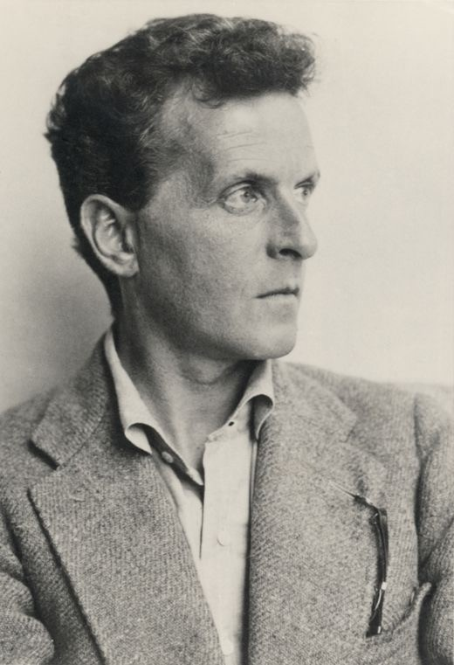
Language as Action
Each turn in a dialogue is a kind of action
Wittgenstein (1953) and Austin (1962)

Slide 18
Speech Acts (aka Dialogue Acts)
Bach and Harnish (1979)
Constatives: committing the speaker to something’s being the case (answering, claiming, confirming, denying, disagreeing, stating)
Directives: attempts by the speaker to get the addressee to do something (advising, asking, forbidding, inviting, ordering, requesting)
Commissives: committing the speaker to some future course of action (promising, planning, vowing, betting, opposing)
Acknowledgments: express the speaker’s attitude regarding the hearer with respect to some social action (apologizing, greeting, thanking, accepting an acknowledgment)

Slide 19
Speech acts
"Turn up the music!"
Directive
"What day in May do you want to travel?"
Directive
"I need to travel in May"
Constative
Thanks
Acknowledgement

Slide 20
Grounding
Participants in conversation or any joint activity need to establish common ground.
Principle of closure. Agents performing an action require evidence, sufficient for current purposes, that they have succeeded in performing it (Clark 1996, after Norman 1988)
Speech is an action too! So speakers need to ground each other’s utterances.
  Grounding: acknowledging that the hearer has understood

Slide 21
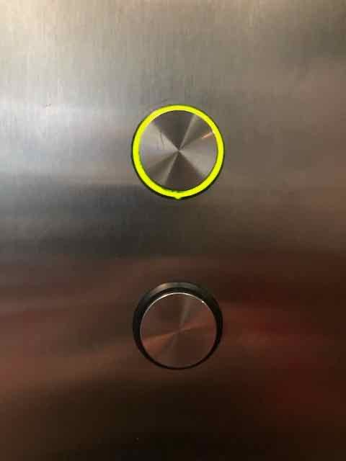
Grounding
Grounding is relevant for human-machine interaction
  Why do elevator buttons light up?

Slide 22
Grounding: Establishing Common Ground
A: And you said returning on May 15th? C: Uh, yeah, at the end of the day.
A: OK
C: OK I’ll take the 5ish flight on the night before on the 11th.
A: On the 11th? OK.
C: ...I need to travel in May.
A: And, what day in May did you want to travel?

Slide 23


Grounding is important for computers too!
Cohen et al (2004)
System: Did you want to review some more of your profile? User: No.
System: What’s next?
System: Did you want to review some more of your profile? User: No.
System: Okay, what’s next?

Slide 24
Conversations have structure
Local structure between adjacent speech acts, from the field of conversational analysis (Sacks et al. 1974)
Called adjacency pairs:
Question… Answer
Proposal… Acceptance/Rejection
COMPLIMENTS ("Nice jacket!")… DOWNPLAYER ("Oh, this old thing?")

Slide 25
Another kind of structure: Subdialogues
Correction subdialogue
Agent: OK. There's #two non-stops#
Client: #Act- actually#, what day of the week is the 15th? Agent: It’s a Friday.
Client: Uh hmm. I would consider staying there an extra day til Sunday.
Agent: OK...OK. On Sunday I have ...
25

Slide 26
Clarification Subdialogues
User: What do you have going to UNKNOWN WORD on the 5th?
System: Let’s see, going where on the 5th? User: Going to Hong Kong.
System: OK, here are some flights...
26

Slide 27
Presequences
User: Can you make train reservations? System: Yes I can.
User: Great, I’d like to reserve a seat on the 4pm train to New York.

Slide 28
Conversational Initiative
Some conversations are controlled by one person
A reporter interviewing a chef asks questions, and the chef responds.
This reporter has the conversational initiative (Walker and Whittaker 1990)
Most human conversations have mixed initiative:
  I lead, then you lead, then I lead.
Mixed initiative is very hard for NLP systems, which often default to simpler styles that can be frustrating for humans:
  User initiative (user asks or commands, system responds)
  System initiative (system asks user questions to fill out a form, user can't change the direction)

Slide 29
Even harder problems: Inference
Agent: And, what day in May did you want to travel? Client: OK, uh, I need to be there for a meeting that’s from the 12th to the 15th.

Slide 30
Properties of Human Conversation
Chatbots and Dialogue Systems

Slide 31
Rule-based Chatbots: ELIZA and PARRY
Chatbots and Dialogue Systems

Slide 32
ELIZA: Weizenbaum (1966)
Men are all alike. IN WHAT WAY
They're always bugging us about something or other. CAN YOU THINK OF A SPECIFIC EXAMPLE
Well, my boyfriend made me come here. YOUR BOYFRIEND MADE YOU COME HERE
He says I'm depressed much of the time.
I AM SORRY TO HEAR YOU ARE DEPRESSED
...
You are like my father in some ways. WHAT RESEMBLANCE DO YOU SEE
Weizenbaum, Joseph. 1966, "ELIZA - A Computer Program For the Study of Natural Language Communication Between Man And Machine", Communications of the ACM 9 (1): 36-45
You are not very aggressive but I think you don’t want me to notice that. WHAT MAKES YOU THINK I AM NOT AGGRESSIVE
You don’t argue with me.
WHY DO YOU THINK I DON’T ARGUE WITH YOU
You are afraid of me.
DOES IT PLEASE YOU TO BELIEVE I’M AFRAID OF YOU
My father is afraid of everybody.
WHAT ELSE COMES TO MIND WHEN YOU THINK OF YOUR FATHER
Bullies.
DOES THAT HAVE ANYTHING TO DO WITH THE FACT THAT YOUR BOYFRIEND MADE YOU COME HERE

Slide 33
ELIZA's trick: be a Rogerian psychologist
Draw the patient out by reflecting patient’s statements back at them
Rare type of conversation in which one can “assume the pose of knowing almost nothing of the real world”

Slide 34
Rogerian psychologist
Patient: "I went for a long boat ride” Psychologist: "Tell me about boats”
You don’t assume she didn’t know what a boat is You assume she had some conversational goal
Chatbots trying to pass the Turing test usually choose some such domain

Slide 35
Eliza pattern/transform rules
(0 YOU 0 ME) [pattern]
→
(WHAT MAKES YOU THINK I 3 YOU) [transform]
0 means Kleene *
The 3 is the constituent # in pattern
You hate me
WHAT MAKES YOU THINK I
HATE YOU

Slide 36
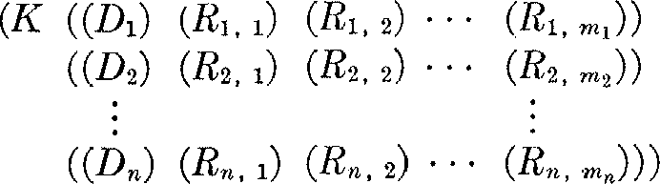
Eliza Rules
Rules are organized by keywords
Each keyword has a pattern and a list of possible transform
Keyword: YOU
Pattern: (0 YOU 0 ME)
Transforms: (WHAT MAKES YOU THINK I 3 YOU) (WHY DO YOU THINK I 3 YOU)
keyword pattern list of transforms

Slide 37
Keywords are ranked from specific to general
User: I know everybody laughed at me
“I” is very general:
I: (I *) -> (YOU SAY YOU 2)
ELIZA: YOU SAY YOU KNOW EVERYBODY LAUGHED AT YOU
“Everybody” is more specific and interesting
Everybody: (Everybody *) -> (WHO IN PARTICULAR ARE YOU
ELIZA: WHO IN PARTICULAR ARE YOU THINKING OF?
THINKING OF)
Implementation: keywords stored with their rank
Everybody I
5 (list
0 (list
of transformation
of transformation
rules) rules)

Slide 38
function ELIZA GENERATOR(user sentence) returns response
Find the word w in sentence that has the highest keyword rank
if w exists
Choose the highest ranked rule r for w that matches sentence response ← Apply the transform in r to sentence
if w = ‘my’
future ← Apply a transformation from the ‘memory’ rule list to sentence
Push future onto memory stack
else (no keyword applies)
either
response ← Apply the transform for the NONE keyword to sentence
or
response ← Pop the top response from the memory stack
return(response)

Slide 39
NONE
PLEASE GO ON
THAT’S VERY INTERESTING I SEE

Slide 40
Memory
(MEMORY MY
(0 MY 0 = LETS DISCUSS FURTHER WHY YOUR 3)
(0 MY 0 = EARLIER YOU SAID YOUR 3)
(0 MY 0 = DOES THAT HAVE ANYTHING TO DO WITH THE FACT THAT YOUR 3))
Whenever “MY” is highest keyword
Randomly select a transform on the MEMORY list
Apply to sentence
Store on a (first-in-first-out) queue
Later, if no keyword matches a sentence
Return the top of the MEMORY queue instead

Slide 41
Ethical implications: Anthropomorphism and Privacy
People became deeply emotionally involved with the program
One of Weizenbaum's staff asked him to leave the room when she talked with ELIZA
When he suggested that he might want to store all the ELIZA conversations for later analysis, people immediately pointed out the privacy implications
Suggesting that they were having quite private conversations with ELIZA
Despite knowing that it was just software.

Slide 42
Ethical implications
It worried Weizenbaum that people confided in ELIZA
Were people misled about how much computers understood? Turkle studied users of ELIZA and other systems
Turkle has shown human face-to-face interaction is vital
But people also develop specific relationships with artifacts
Some users told her ELIZA was more like a kind of diary, a way to privately explore their thoughts.
Importance of value-sensitive design
Joseph Weizenbaum. 1976. Computer Power and Human Reason: From Judgment to Calculation. WH Freeman. Sherry Turkle. 2011. Taking Things at Interface Value, chapter in Life on the Screen. Simon and Schuster.
Sherry Turkle. 2007. Authenticity in the age of digital companions. Interaction Studies, 8(3), pp.501-517

Slide 43
PARRY: A computational model of schizophrenia
Another chatbot with a clinical psychology focus
Colby, K. M., Weber, S., and Hilf, F. D. (1971). Artificial paranoia.
Artificial Intelligence 2(1), 1–25.
Used to study schizophrenia
Same pattern-response structure as Eliza But a much richer:
  control structure
  language understanding capabilities
  model of mental state.
    variables modeling levels of Anger, Fear, Mistrust

Slide 44
Affect variables
Fear (0-20) Anger (0-20) Mistrust (0-15)
Start with all variables low After each user turn
Each user statement can change Fear and Anger
  E.g., Insults increases Anger, Flattery decreases Anger
  Mentions of his delusions increase Fear
Else if nothing malevolent in input
  Anger, Fear, Mistrust all drop

Slide 45
Parry's responses depend on mental state
User Input
Modify Affect variables
condition
excessive fear
excessive anger
mentions delusion
question
…
response
Escape
Hostility
Fear
answer

Slide 46
PARRY passes the Turing test in 1972
The first system to pass a version of the Turing test
Psychiatrists couldn’t distinguish interviews with PARRY from (text transcripts of) interviews with people diagnosed with paranoid schizophrenia
Colby, K. M., Hilf, F. D., Weber, S., and Kraemer, H. C. (1972). Turing-like indistinguishability tests for the validation of a computer simulation of paranoid processes. Artificial Intelligence 3, 199–221.

Slide 47
Rule-based Chatbots: ELIZA and PARRY
Chatbots and Dialogue Systems

Slide 48
Corpus-based Chatbots
Chatbots and Dialogue Systems

Slide 49
Two architectures for corpus-based chabots
Response by retrieval
Use information retrieval to grab a response (that is appropriate to the context) from some corpus
Response by generation
Use a language model or encoder-decoder to generate the response given the dialogue context

Slide 50
Corpus-based chatbots require corpora
Modern corpus-based chatbots are very data- intensive
They commonly require hundreds of millions or billions of words

Slide 51
What conversations to draw on?
Transcripts of telephone conversations between volunteers
Switchboard corpus of American English telephone conversations
Movie dialogue
Various corpora of movie subtitles
Hire human crowdworkers to have conversations
Topical-Chat 11K crowdsourced conversations on 8 topics
EMPATHETICDIALOGUES 25K crowdsourced conversations grounded in a situation where a speaker was feeling a specific emotion
Pseudo-conversations from public posts on social media
Drawn from Twitter, Reddit, Weibo (微博), etc.
Tend to be noisy; often used just as pre-training.
Crucial to remove personally identifiable information (PII)

Slide 52
Response by retrieval: classic IR method
Given a user turn q, and a training corpus C of conversation
Find in C the turn r that is most similar (tf-idf cosine) to q
Say r
response(q,C) = argmax ^{q · r}
|q||r|
r2C

Slide 53
Response by retrieval: neural IR method
Given a user turn q, and a training corpus C of conversation
Find in C the turn r that is most similar (BERT dot product) to q
Say r
h_{q} = BERT_{Q}(q)[CLS]
h_{r} = BERT_{R}(r)[CLS]
response(q,C) = argmax h_{q} · h_{r}
r2C

Slide 54
Response by generation
Think of response production as an encoder-decoder task
Generate each token r_{t} of the response by conditioning on the encoding of the entire query q and the response so far r₁...r_{t−1}
rˆ_{t} = argmax_{w∈V} P(w|q, r₁...r_{t—1})
r₁ r₂
…
r_{n}
dot-product
h_{q}
ENCODER_{query}
q₁ … q_{n}
h_{r}
DECODER
^{ENCODER}response
r₁ … r_{n}
ENCODER
q₁
… q_{n} r₁ …
<S>
(a) Response by Retrieval
(b) Response by Generation

Slide 55
Response by generation
That is quite an accomplishment and you should be proud!
DECODER
ENCODER
[U:] I finally got promoted today at work! [S:] Congrats! That’s great!
[U:] Thank you! I’ve been trying to get it for a while now!

Slide 56
Response by generation
Alternative approach: fine-tune a large language model on conversational data
The Chirpy Cardinal system (Paranjape et al., 2020):
fine-tunes GPT-2
on the EMPATHETICDIALOGUES dataset (Rashkin et al., 2019)

Slide 57
P.G. Wodehouse predicts neural chatbots
“What ho!” I said. “What ho!” said Motty. “What ho! What ho!”
“What ho! What ho! What ho!”
After that it seemed rather difficult to go on with the conversation.”
Wodehouse My Man Jeeves, 1919

Slide 58
Ongoing research problem:
Neural chatbots can get repetitive and boring
A: Where are you going?
B: I’m going to the restroom. A: See you later.
B: See you later.
A: See you later. B: See you later.
A: How old are you? B: I’m 16.
A: 16?
B: I don’t know what you are talking about. A: You don’t know what you are saying.
B: I don’t know what you are talking about.
A: You don’t know what you are saying.

Slide 59
Response by retrieving and refining knowledge
Can generate responses from informative text rather than dialogue
To respond to turns like “Tell me something about Beijing”
  XiaoIce collects sentences from public lectures and news articles.
  And searches them using IR based on query expansion from user’s turn
Can augment encoder-decoder model
  use IR to retrieve passages from Wikipedia
  concatenate each Wikipedia sentence to the dialogue context with a separator token.
  Give as encoder context to the encoder-decoder model, which learns to incorporate text into its response

Slide 60
Hybrid Architectures
Chirpy Cardinal (Paranjape et al., 2020) response generation from a series of different generators:
GPT-2 finetuned on EmpatheticDialogues
GPT-2 finetuned to paraphrase content from Wikipedia
Rule-based movie or music generators that produce scripted conversation about a movie or a musician
  asking the user’s opinion about a movie,
  giving a fun fact,
  asking the user their opinion on an actor in the movie.

Slide 61
# Utterance
Entity
None
Commentary
1 User: let’s chat
Bot: Hi, this is an Alexa Prize Socialbot. I’d love to get to know you a bit better before we chat! Is it all right if I ask for your name? [ Launch ]
None
Launch gives FORCE_START response to be-
gin the conversation.
2 User: my name is chris
None None
Bot: Well it’s nice to meet you, Chris! I’m excited to chat with you today. [ Launch ] I hope your after-
Launch gives a STRONG_CONTINUE re-
sponse that needs a prompt, which is supplied
noon is going well. What are your plans for the rest of today? [ Neural Chat ]
by Neural Chat with FORCE_START priority
(scripted transition).
3 User: hang out with my friends
Bot: That sounds great, I love spending time with friends. What will you do together? [ Neural Chat ]
None None
None
Chirpy Cardinal
Neural Chat generates a GPT-2 response with
STRONG_CONTINUE priority.
4 User: maybe watch a movie
(Paranjape
Bot: Me too! I love watching movies; I get to learn so much about what the world is like outside of
Film
Movies detects the ‘movie’ keyword in the
et al. 2020)
user’s utterance and gives a FORCE_START
the cloud! Have you seen any movies recently? [ Movies ]
response (overriding Neural Chat), setting
current entity to Film.
5 User: i saw the matrix
The Matrix
The and
iden-
Entity Linker
Entity Tracker
tify The Matrix as the current entity.
Bot: Nice! Did you like The Matrix? [ Movies ]
The Matrix The Matrix
6 User: i loved it neo is amazing
Bot: Oooh, yeah, I agree. Hey, isn’t Keanu Reeves
Keanu
Movies sets current entity to Keanu Reeves.
in that movie? What do you think about Keanu
Reeves
Reeves?
[ Movies ]
7 User: i want to talk about something else
None
Navigational Intent
detects negative intent, so
Entity Tracker
rejects the current entity.

Slide 62
Chatbots: pro and con
Pro:
Fun
Good for narrow, scriptable applications
Cons:
They don't really understand
Giving the appearance of understanding may be problematic
Rule-based chatbots are expensive and brittle
IR-based chatbots can only mirror training data
  We'll discuss later the case of Microsoft Tay
    (or, Garbage-in, Garbage-out)
Next steps: integrating chatbot ability into frame-based agents

Slide 63
Corpus-based Chatbots
Chatbots and Dialogue Systems

Slide 64
The Frame-based ("GUS") Dialogue Architecture
Chatbots and Dialogue Systems

Slide 65
Frame-based dialogue agents
Sometimes called "task-based dialogue agents"
Systems that have the goal of helping a user solve a task like making a travel reservation or buying a product
Architecture:
First proposed in the GUS system of 1977
A knowledge structure representing user intentions
One or more frames (each consisting of slots with values)

Slide 66
The Frame
A set of slots, to be filled with information of a given type
Each associated with a question to the user Sometimes called a domain ontology
Slot
ORIGIN DEST
Type
city city
Question
"What city are you leaving from? "Where are you going?
"What day would you like to leave?
"What time would you like to leave? "What is your preferred airline?
DEP DATE date
DEP TIME time AIRLINE line

Slide 67
Two basic architectures
The GUS architecture
Sometimes just called "frame-based" architecture
Over 40 years old, but still used in most industrial task-based dialogue agents
Bobrow, Daniel G., Ronald M. Kaplan, Martin Kay, Donald A. Norman, Henry Thompson, and Terry Winograd. 1977. "GUS, a frame-driven dialog system." Artificial Intelligence 8, 2:155-173.
The dialogue-state architecture
Extension of GUS
More common in research systems
Some aspects making their way into industrial systems

Slide 68
GUS:
Hello. My name is GUS. I can help you plan a simple trip by air. Where do you want to go ?
I want to go to San Diego on May 28 What time do you want to leave?
I must be in San Diego before 10 am
Would you like P.S.A. flight 102 that arrives at 9.15 am ? What is the next flight ?
Air California flight 310 that leaves at 8.30am and arrives at 10.00am I’ll take the first one
In what name should I make a reservation, please? Dan Bobrow
I have confirmed the following flight: P.S.A. flight 102 on Wednesday May 28 from San Jose to San Diego that leaves at 7.30 am and arrives at 9.15 am.
What date do you want to return on ? On Friday in the evening.
Would you like the flight that leaves at 7.45 pm ? That’s fine.
I have confirmed the following flight: P.S.A. flight 307 on Friday May 30 from San Diego to San Jose that leaves at 7.45 pm and arrives at 9.30 pm Thank you for calling. Goodbye
Client: GUS:
Client: GUS:
Client: GUS:
Client: GUS:
Client: GUS:
GUS:
Client: GUS:
Client: GUS:

Slide 69
Control structure for GUS frame architecture
System asks questions of user, filling any slots that user specifies
User might fill many slots at a time:
I want a flight from San Francisco to Denver one way leaving after five p.m. on Tuesday.
When frame is filled, do database query

Slide 70
GUS slots have condition-action rules attached
Some rules attached to the DESTINATION slot for the plane booking frame
Once the user has specified the destination
  Enter that city as the default StayLocation for the hotel booking frame.
Once the user has specified DESTINATION DAY for a short trip
  Automatically copy as ARRIVAL DAY.

Slide 71
GUS systems have multiple frames
Frames like:
Car or hotel reservations
General route information
  Which airlines fly from Boston to San Francisco?,
Information about airfare practices
  Do I have to stay a specific number of days to get a decent airfare?).
Frame detection:
System must detect which slot of which frame user is filling
And switch dialogue control to that frame.

Slide 72
GUS: Natural Language Understanding for filling dialog slots
Domain classification
Asking weather? Booking a flight? Programming alarm clock?
Intent Determination
Find a Movie, Show Flight, Remove Calendar Appt
Slot Filling
Extract the actual slots and fillers

Slide 73
Natural Language Understanding for filling slots
Show me morning flights from Boston to SF on Tuesday.
DOMAIN: INTENT: ORIGIN-CITY: ORIGIN-DATE: ORIGIN-TIME: DEST-CITY:
AIR-TRAVEL SHOW-FLIGHTS
Boston Tuesday morning
San Francisco

Slide 74
Natural Language Understanding for filling slots
Wake me tomorrow at six.
DOMAIN: INTENT: TIME:
ALARM-CLOCK SET-ALARM
2017-07-01 0600-0800

Slide 75
How to fill slots?
(1) Rule-based Slot-filling
Write regular expressions or grammar rules
Wake me (up) | set (the|an) alarm me up
Do text normalization
| get

Slide 76
Generating responses: template-based generation
A template is a pre-built response string
Templates can be fixed: "Hello, how can I help you?"
Or have variables:
"What time do you want to leave CITY-ORIG?" "Will you return to CITY-ORIG from CITY-DEST?"

Slide 77
Summary: simple frame-based architecture
Like many rule-based approaches
Positives:
  High precision
  Can provide coverage if the domain is narrow
Negatives:
  Can be expensive and slow to create rules
  Can suffer from recall problems

Slide 78
The Frame-based ("GUS") Dialogue Architecture
Chatbots and Dialogue Systems

Slide 79
The Dialogue-State Architecture
Chatbots and Dialogue Systems

Slide 80
Dialogue-State or Belief-State Architecture
A more sophisticated version of the frame-based architecture
Has dialogue acts, more ML, better generation The basis for modern research systems
Slowly making its way into industrial systems
Some aspects (ML for slot-understanding) already widely used industrially

Slide 81


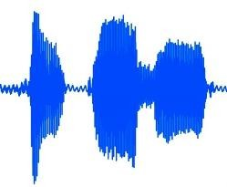




LEAVING FROM DOWNTOWN | 0.6
LEAVING AT ONE P M | 0.2
ARRIVING AT ONE P M | 0.1
{ from: downtown } | 0.5
{ depart-time: 1300 } | 0.3
{ arrive-time: 1300 } | 0.1
Automatic Speech Recognition (ASR)
Spoken Language Understanding (SLU)
Dialog State Tracker (DST)
The Dialogue-State Architecture
from: to:
downtown airport
Williams, Jason D., Antoine Raux, and Matthew Henderson. "The dialog state tracking challenge series: A review." Dialogue & Discourse 7, no. 3 (2016): 4-33.
f
rom: CMU
o: airport
epart-time: 1300 onfirmed: no
_{f} t
_{t} d
depart-time: -- confirmed: no
score: 0.65
rom: CMU
o: airport
epart-time: 1300 onfirmed: no
_{d} c
_{c} score: 0.15
score: 0.10
FROM DOWNTOWN, IS THAT RIGHT?
act: confirm from: downtown
Text to Speech (TTS)
Natural Language Generation (NLG)
Dialog Policy

Slide 82
Components in a dialogue-state architecture
NLU: extracts slot fillers from the user’s utterance using machine learning
Dialogue state tracker: maintains the current state of the dialogue (user’s most recent dialogue act, set of slot-filler constraints from user
Dialogue policy: decides what the system should do or say next
GUS policy: ask questions until the frame was full then report back
More sophisticated: know when to answer questions, when to ask a clarification question, etc.
NLG: produce more natural, less templated utterances

Slide 83
Dialogue Acts
Combine the ideas of speech acts and grounding into a single
representation
Young et al., 2010:
Tag | Sys User |  | Description
HELLO(a = x, b = y, ...) | X | X | Open a dialogue and give info a = x, b = y, ...
INFORM(a = x, b = y, ...) | X | X | Give info a = x, b = y, ...
REQUEST(a, b = x, ...) | X | X | Request value for a given b = x, ...
REQALTS(a = x, ...) | c | X | Request alternative with a = x, ...
CONFIRM(a = x, b = y, ...) | X | X | Explicitly confirm a = x, b = y, ...
CONFREQ(a = x,..., d) | X | c | Implicitly confirm a = x, ... and request value of d
SELECT(a = x, a = y) | X | c | Implicitly confirm a = x, ... and request value of d
AFFIRM(a = x, b = y, ...) | X | X | Affirm and give further info a = x, b = y, ...
NEGATE(a = x) | c | X | Negate and give corrected value a = x
DENY(a = x) | c | X | Deny that a = x
BYE() | X | X | Close a dialogue

Slide 84
Dialogue Acts
Young et al., 2010:
Utterance Dialogue act U: Hi, I am looking for somewhere to eat. hello(task = find,type=restaurant) S: You are looking for a restaurant. What confreq(type = restaurant, food) type of food do you like? U: I’d like an Italian somewhere near the inform(food = Italian, near=museum) museum. S: Roma is a nice Italian restaurant near inform(name = "Roma", type = restaurant, the museum. food = Italian, near = museum) U: Is it reasonably priced? confirm(pricerange = moderate) S: Yes, Roma is in the moderate price affirm(name = "Roma", pricerange = range. moderate)
U: | What is the phone number? | request(phone)
S: | The number of Roma is 385456. | inform(name = | "Roma", | phone | = | "385456")
U: | Ok, thank you goodbye. | bye()

Slide 85
Slot filling: Machine learning
Machine learning classifiers to map words to semantic frame-fillers Given a set of labeled sentences
Input: "I want to fly to San Francisco on Monday please"
Output: Destination: SF Depart-time: Monday
Build a classifier to map from one to the other Requirements: Lots of labeled data

Slide 86
Slot filling as sequence labeling: BIO tagging
The BIO tagging paradigm
Idea: Train a classifier to label each input word with a tag that tells us what slot (if any) it fills
We create a B and I tag for each slot-type And convert the training data to this format
O | O | O | O | O | B-DES | I-DES | O | B-DEPTIME | I-DEPTIME | O
I | want | to | fly | to | San | Francisco | on | Monday | afternoon | please

Slide 87

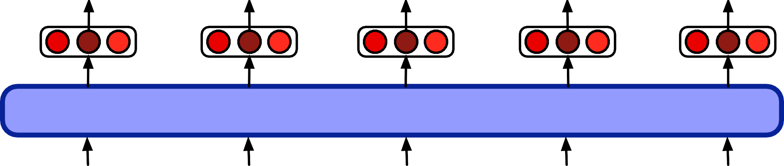
Slot filling using contextual embeddings
Can do domain and intent too: e.g., generate the label "AIRLINE_TRAVEL + SEARCH_FLIGHT"
B-DES I-DES O B-DTIME d+i
Classifier
+softmax
Encodings
Encoder (BERT)
San Francisco on
…
Monday
<EoS>

Slide 88
Once we have the BIO tag of the sentence
O | O | O | O | O | B-DES | I-DES | O | B-DEPTIME | I-DEPTIME | O
I | want | to | fly | to | San | Francisco | on | Monday | afternoon | please
We can extract the filler string for each slot
And then normalize it to the correct form in the ontology
Like "SFO" for San Francisco
Using homonym dictionaries (SF=SFO=San Francisco)

Slide 89
The task of dialogue state tracking
User:
I’m looking for a cheaper restaurant
inform(price=cheap)
System: Sure. What kind - and where?
User: Thai food, somewhere downtown
inform(price=cheap, food=Thai, area=centre)
System: The House serves cheap Thai food
User:
Where is it?
inform(price=cheap, food=Thai, area=centre); request(address)
System: The House is at 106 Regent Street
Example from Mrkšić, N., O Séaghdha, D., Wen, T.-H., Thomson, B., and
Young, S. (2017). Neural belief tracker: Data-driven dialogue state tracking. ACL.

Slide 90
Dialogue state tracking
I'd like Cantonese food near the Mission district.
→
inform(food=cantonese, area=mission).
Dialogue act interpretation algorithm:
1-of-N supervised classification to choose inform
Based on encodings of current sentence + prior dialogue acts Simple dialogue state tracker:
Run a slot-filler after each sentence

Slide 91
An special case of dialogue act detection: Detecting Correction Acts
If system misrecognizes an utterance User might make a correction
Repeat themselves
Rephrasing
Saying “no” to a confirmation question

Slide 92
Corrections are harder to recognize!
From speech, corrections are misrecognized twice as often (in terms of word error rate) as non-corrections! (Swerts et al 2000)
Hyperarticulation (exaggerated prosody) is a large factor:
  Shriberg, E., Wade, E., Price, P., 1992. Human-machine problem solving using spoken language systems (SLS): Factors affect-ng performance and user satisfaction. DARPA Speech and Natural Language Workshop.
"I said BAL-TI-MORE, not Boston"

Slide 93
Features for detecting corrections in spoken dialogue
features | examples
lexical | words like “no”, “correction”, “I don’t”, swear words, utterance length
semantic | similarity (word overlap or embedding dot product) between the candidate correction act and the user’s prior utterance
phonetic | phonetic overlap between the candidate correction act and the user’s prior ut- terance (i.e. “WhatsApp” may be incorrectly recognized as “What’s up”)
prosodic | hyperarticulation, increases in F0 range, pause duration, and word duration, generally normalized by the values for previous sentences
ASR | ASR confidence, language model probability

Slide 94
The Dialogue-State Architecture
Chatbots and Dialogue Systems

Slide 95
The Dialogue-State Architecture Continued: Policy and Generation
Chatbots and Dialogue Systems

Slide 96
Dialogue Policy
At turn i predict action A_{i} to take, given entire history:
A^{ˆ}_{i} = argmax P(A_{i}|(A₁,U₁, ..., A_{i—1},U_{i—1})
A_{i}∈A
Simplify by just conditioning on the current dialogue state (filled frame slots) and the last turn and turn by system and user:
A^{ˆ}_{i} = argmax P(A_{i}|Frame_{i—1}, A_{i—1},U_{i—1})
A_{i}∈A

Slide 97
Policy example: Confirmation and Rejection
Dialogue systems make errors
So they to make sure they have understood user Two important mechanisms:
confirming understandings with the user
rejecting utterances that the system is likely to have misunderstood.

Slide 98
Explicit confirmation strategy
S: Which city do you want to leave from? U: Baltimore.
S: Do you want to leave from Baltimore?
U: Yes.
U: I’d like to fly from Denver Colorado to New York City on September twenty first in the morning on United Airlines
S: Let’s see then. I have you going from Denver Colorado to New York on September twenty first. Is that correct?
U: Yes

Slide 99
Implicit confirmation strategy
U: I want to travel to Berlin
S: When do you want to travel to Berlin?
U2: Hi I’d like to fly to Seattle Tuesday Morning
A3: Traveling to Seattle on Tuesday, August eleventh in the morning.
Your full name?

Slide 100
Confirmation strategy tradeoffs
Explicit confirmation makes it easier for users to correct the system’s misrecognitions since a user can just answer “no” to the confirmation question.
But explicit confirmation is also awkward and increases the length of the conversation (Danieli and Gerbino 1995, Walker et al. 1998).

Slide 101
Rejection
I’m sorry, I didn’t understand that.

Slide 102
Progressive prompting for rejection
Don't just repeat the question "When would you like to leave?" Give user guidance about what they can say:
System: When would you like to leave?
Caller: Well, um, I need to be in New York in time for the first World Series game.
System: <reject>. Sorry, I didn’t get that. Please say the month and day you’d like to leave.
Caller: I wanna go on October fifteenth.

Slide 103
Using confidence to decide whether to confirm:
ASR or NLU systems can assign a confidence value, indicating how likely they are that they understood the user.
Acoustic log-likelihood of the utterance
Prosodic features
Ratio of score of best to second-best interpretation
Systems could use set confidence thresholds:
< a | low confidence | reject
≥ a | above the threshold | confirm explicitly
≥ b | high confidence | confirm implictly
≥ g | very high confidence | don’t confirm at all

Slide 104
Natural Language Generation
NLG in information-state architecture modeled in two stages:
content planning (what to say)
sentence realization (how to say it).
We'll focus on sentence realization here.

Slide 105
Sentence Realization
Assume content planning has been done by the dialogue policy
Chosen the dialogue act to generate
Chosen some attributes (slots and values) that the planner wants to say to the user
  Either to give the user the answer, or as part of a confirmation strategy)

Slide 106
2 samples of Input and Output for Sentence Realizer
recommend(restaurant name= Au Midi, neighborhood = midtown, cuisine = french
Au Midi is in Midtown and serves French food.
There is a French restaurant in Midtown called Au Midi.
recommend(restaurant name= Loch Fyne, neighborhood = city
centre, cuisine = seafood)
Loch Fyne is in the City Center and serves seafood food.
There is a seafood restaurant in the City Centre called Loch Fyne.

Slide 107
Sentence Realization
Training data is hard to come by
Don't see each restaurant in each situation Common way to improve generalization:
Delexicalization: replacing words in the training set that represent slot values with a generic placeholder token:
recommend(restaurant name= Au Midi, neighborhood = midtown, cuisine = french
  Au Midi is in Midtown and serves French food.
  There is a French restaurant in Midtown called Au Midi.

Slide 108
Sentence Realization
Training data is hard to come by
Don't see each restaurant in each situation Common way to improve generalization:
Delexicalization: replacing words in the training set that represent slot values with a generic placeholder token:
recommend(restaurant name= Au Midi, neighborhood = midtown,
cuisine = french
restaurant name is in neighborhood and serves cuisine food.
There is a cuisine restaurant in neighborhood called restaurant name.

Slide 109
Sentence Realization: mapping from frames to delexicalized sentences
[name] has decent
service
Encoder-decoder models:
DECODER
ENCODER
RECOMMEND service: decent cuisine: null
Output:
restaurant_name has decent service
Relexicalize to:
Au Midi has decent service

Slide 110
Generating clarification questions
User: What do you have going to UNKNOWN WORD on the 5th? System: Going where on the 5th?
The system repeats “going” and “on the 5th” to make it clear which aspect of the user’s turn the system needs to be clarified
Methods for generating clarification questions:
Rules like 'replace “going to UNKNOWN WORD” with “going where”'
Classifiers that guess which slots were misrecognized

Slide 111
The Dialogue-State Architecture Continued: Policy and Generation
Chatbots and Dialogue Systems

Slide 112
Evaluating Dialogue Systems
Chatbots and Dialogue Systems

Slide 113
Evaluating chatbots and task-based dialogue
Task-based dialogue:
mainly by measuring task performance Chatbots:
mainly by human evaluation

Slide 114
Chatbots are evaluated by humans
Participant evaluation: The human who talked to the chatbot assigns a score
Observer evaluation: third party who reads a transcript of a human/chatbot conversation assigns a score.

Slide 115
Participant evaluation
Human chats with model for 6 turns and rates 8 dimensions of quality:
avoiding repetition, interestingness, making sense, fluency, listening, inquisitiveness, humanness, engagingness,
Avoiding Repetition: How repetitive was this user?
  •Repeated themselves over and over •Sometimes said the same thing twice • Always said something new
(3) Making sense: How often did this user say something which didn't make sense?
•Never made any sense •Most responses didn’t make sense •Some responses didn’t make sense •Everything made perfect sense
(8) Engagingness: How much did you enjoy talking to this user?
•Not at all •A little •Somewhat •A lot
Abigail See, Stephen Roller, Douwe Kiela, Jason Weston. 2019. What makes a good conversation? How controllable attributes affect human judgments. NAACL.

Slide 116
Observer evaluation: acute-eval
Li, M., Weston, J., and Roller, S. (2019). Acute-eval: Improved dialogue evaluation with optimized questions and multi-turn comparisons. NeurIPS19 Workshop on Conversational AI.
Annotators look at two conversations (A + B) and decide which is better:
Engagingness: Who would you prefer to talk to for a long conversation?
Interestingness: If you had to say one of these speakers is interesting and one is boring, who would you say is more interesting?
Humanness: Which speaker sounds more human?
Knowledgeable: If you had to say that one speaker is more knowledgeable and one is more ignorant, who is more knowledgeable?

Slide 117
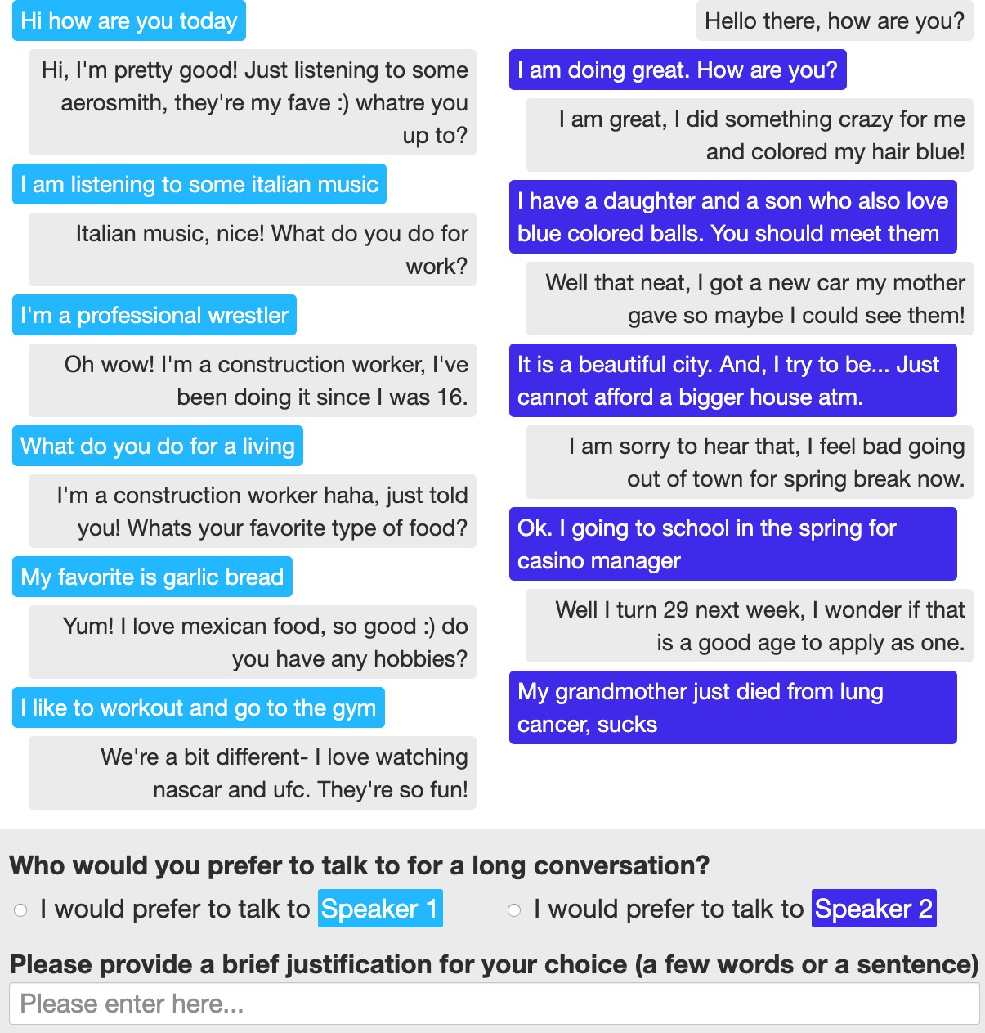
The ACUTE-EVAL
method
Li et el., 2019
Figure from Li, M., Weston, J., and Roller, S. (2019). Acute-eval: Improved dialogue evaluation with optimized questions and multi-turn comparisons. NeurIPS19 Workshop on Conversational AI.

Slide 118
Automatic evaluation is an open problem
Automatic evaluation methods (like the BLEU scores used for Machine Translation) are generally not used for chatbots.
They correlate poorly with human judgements. One current research direction: Adversarial Evaluation
Inspired by the Turing Test
train a ``Turing-like'' classifier to distinguish between human responses and machine responses.
The more successful a dialogue system is at fooling the evaluator, the better the system.

Slide 119
Task-based systems are evaluated by task success!
End-to-end evaluation (Task Success)
Slot Error Rate for a Sentence
# of inserted/deleted/subsituted slots # of total reference slots for sentence

Slide 120
Evaluation Metrics: Slot error rate
“Make an appointment with Chris at 10:30 in Gates 104”
Slot | Filler
PERSON | Chris
TIME | 11:30 a.m.
ROOM | Gates 104
Slot error rate: 1/3
Task success: At end, was the correct meeting added to the calendar?

Slide 121
More fine-grained metrics: User Satisfaction Survey
Walker, Marilyn, Candace Kamm, and Diane Litman. "Towards developing general models of usability with PARADISE." Natural Language Engineering 6, no. 3 & 4 (2000): 363-377.
TTS Performance ASR Performance Task Ease Interaction Pace User Expertise System Response Expected Behavior Future Use
Was the system easy to understand ?
Did the system understand what you said?
Was it easy to find the message/flight/train you wanted? Was the pace of interaction with the system appropriate? Did you know what you could say at each point?
How often was the system sluggish and slow to reply to you? Did the system work the way you expected it to?
Do you think you’d use the system in the future?

Slide 122
Other Heuristics
Efficiency cost:
total elapsed time for the dialogue in seconds,
the number of total turns or of system turns
total number of queries
“turn correction ratio”: % of turns that were used to correct errors
Quality cost:
number of ASR rejection prompts.
number of times the user had to barge in

Slide 123
Evaluating Dialogue Systems
Chatbots and Dialogue Systems

Slide 124
Design and Ethical Issues
Chatbots and Dialogue Systems

Slide 125
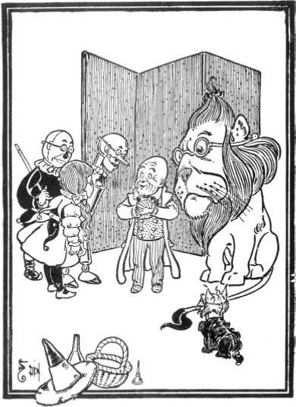
Dialog System Design: User-centered Design
Study the users and task
  value-sensitive design
Build simulations
  Wizard of Oz study
Iteratively test design on users
Gould, John D., and Clayton Lewis. "Designing for usability: key principles and what designers think." Communications of the ACM 28, no. 3 (1985): 300-311.
Bender, Emily M., and Batya Friedman. "Data statements for natural language processing: Toward mitigating system bias and enabling better science." TACL 6 (2018): 587-604.

Slide 126
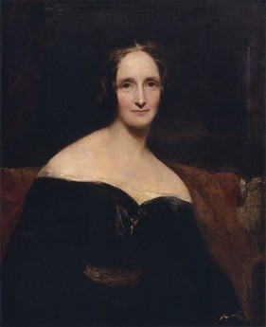
Ethical design
Ethical issues have long been known to be crucial in artificial agents
Mary Shelley's Frankenstein
creating agents without a consideration of ethical and humanistic concerns
Ethical issues:
Safety: Systems abusing users, distracting drivers, or giving bad medical advice
Representational harm: Systems demeaning particular social groups
Privacy: Information Leakage

Slide 127
Safety
Chatbots for mental health
Extremely important not to say the wrong thing
In-vehicle conversational agents
Must be aware of environment, driver's level of attention
Peter Henderson, Koustuv Sinha, Nicolas Angelard-Gontier, Nan Rosemary Ke, Genevieve Fried, Ryan Lowe, and Joelle Pineau. 2018. Ethical Challenges in Data-Driven Dialogue Systems. In 2018 AAAI/ACM Conference on AI, Ethics, and Society (AIES ’18),

Slide 128
Abuse and Representation Harm: The case of Microsoft Tay
Experimental Twitter chatbot launched in 2016
given the profile personality of an 18- to 24-year-old American woman
could share horoscopes, tell jokes,
asked people to send selfies
used informal language, slang, emojis, and GIFs,
Designed to learn from users (IR-based)

Slide 129
The case of Microsoft Tay
Immediately Tay turned offensive and abusive
Obscene and inflammatory tweets
Nazi propaganda, conspiracy theories
Began harassing women online
Reflecting racism and misogyny of Twitter users
Microsoft took Tay down after 16 hours
Lessons:
User response must be considered in the design phase
Gina Neff and Peter Nagy 2016. Talking to Bots: Symbiotic Agency and the Case of Tay. International Journal of Communication 10(2016), 4915–4931

Slide 130
Bias in training datasets
Henderson et al. ran hate-speech and bias detectors on standard training sets for dialogue systems:
Twitter, Reddit, other dialogue datasets
Found bias and hate-speech
In training data
In dialogue models trained on the data
Peter Henderson, Koustuv Sinha, Nicolas Angelard-Gontier, Nan Rosemary Ke, Genevieve Fried, Ryan Lowe, and Joelle Pineau. 2018. Ethical Challenges in Data-Driven Dialogue Systems. In 2018 AAAI/ACM Conference on AI, Ethics, and Society (AIES ’18),

Slide 131
Privacy: Training on user data
Accidental information leakage
“Computer, turn on the lights [answers the phone] Hi, yes, my password is...”
Henderson show in simulation that this leakage can occur.
Intentional information leakage
Dialogue systems that are designed to send user data to developer or advertisers
Important to consider privacy-preserving dialogue systems
Peter Henderson, Koustuv Sinha, Nicolas Angelard-Gontier, Nan Rosemary Ke, Genevieve Fried, Ryan Lowe, and Joelle Pineau. 2018. Ethical Challenges in Data-Driven Dialogue Systems. In 2018 AAAI/ACM Conference on AI, Ethics, and Society (AIES ’18),
Campagna, Giovanni, Rakesh Ramesh, Silei Xu, Michael Fischer, and Monica S. Lam. "Almond: The architecture of an open, crowdsourced, privacy-preserving, programmable virtual assistant." In Proceedings of the 26th International Conference on World Wide Web, pp. 341-350. 2017.

Slide 132
Design and Ethical Issues
Chatbots and Dialogue Systems

